Slide 1
Brainteaser Time!
Notes:
Present this brainteaser without giving context that the presentation is about gender equity.
Ask people who have seen it before to not give away the answer to those who haven’t.

Slide 2
A father and his son are in a car accident.
The father dies on the spot.
The son, badly injured, is taken to the hospital.
In the ER, the attending surgeon looks at the boy and says,
“I can’t operate on this boy. He’s my son!”
Who is the surgeon?

Slide 3
Surgeon
Notes:
This is a google image search of the word “surgeon”. The image of a white male is what many people associate with the word “surgeon”.

Slide 4
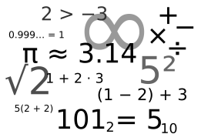
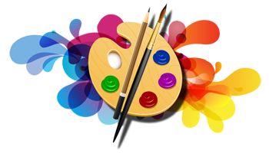
Implicit Bias
Most people associate…
Science and math with “male”
Humanities and arts with “female”

Slide 5
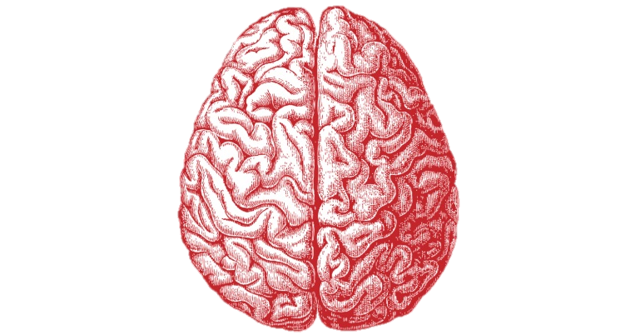
Implicit Bias
Definition: the attitudes or stereotypes that affect our understanding, actions, and decisions in an unconscious manner.
They are activated without awareness or intentional control, and are not accessible through introspection.
Notes:
Key: implicit bias is unconscious, not intentional, and we can’t tell which ones we have simply by thinking about it.

Slide 6
Implicit Bias
We all have implicit biases.
They do not necessarily align with our declared beliefs.
We can hold implicit biases against our own in-group.
The implicit biases we have formed can be unlearned.
Take a test to learn about your unconscious bias at https://implicit.harvard.edu.
Notes:
Tests at link cover not just gender and science, but many common implicit associations around people of different ages, weights, races, and religions.

Slide 7
Purpose
Examine ways girls can be subconsciously excluded from interacting with science
Learn strategies for engaging girls when talking about science
Inspire Her Mind

Slide 8
The Facts: Gender Bias in the Classroom
Boys' work is praised for content, while girls' work is often praised for its appearance. (Liu, 2006)
Notes:
Tip for scientists: Pay attention to the type of feedback you’re giving to visitors. Make sure comments are not unintentionally focused more on the appearance or aesthetics of the work for girls.
Example in museum: greeters asking boys what they’re excited to see at OMSI, and telling girls how cute their outfits are.

Slide 9
The Facts: Gender Bias in the Classroom
Girls are often assigned passive roles such as reading instructions, recording results, or taking notes, while boys use equipment and complete the tasks (Scantlebury & Baker, 2007).
Notes:
Tip for scientists: If roles are assigned in your demo, make sure the “doing” role is assigned equally to boys and girls, or give everyone a turn for each role.

Slide 10
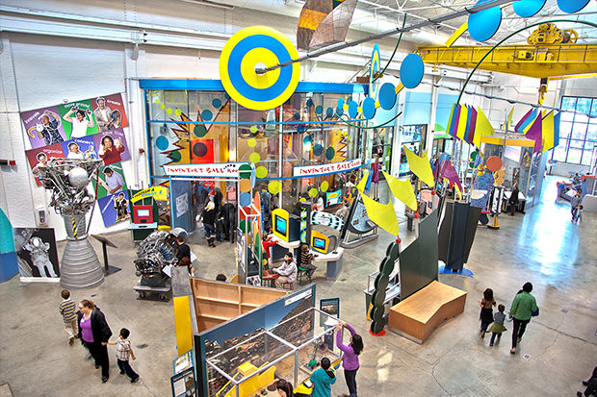
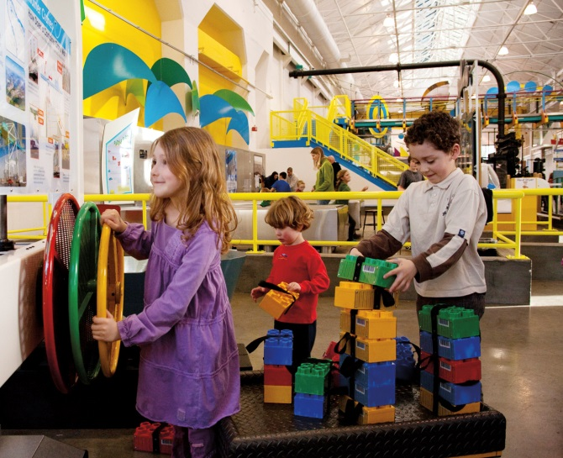
The Facts: Gender Roles at the Museum
Boys are three times more likely than girls to hear explanations of science from their parents when exploring science exhibits (Crowley, 2001).
Notes:
Girls will hear instructions of what to do, and observations about what happens, but boys will hear why it happens and the science concepts behind it.
Tip for scientists: Pay attention to how you explain the science concepts. Are you giving more in depth explanations of the science when talking to boys than with girls?

Slide 11
The Facts: Gender Roles at the Museum
When interacting with a display, boys are more likely to jump in and play, while girls are more thoughtful in their approach (Wohre and Harrasser, 2011).
Notes:
Example story at Meet a Scientist where boy walked up first and his sister walked up a few seconds later. Scientist directed all instruction at boy, and gave him all the hands-on things to try, until the girl finally left.
Tip for scientists: Visitors should be invited in! If they look a little hesitant, ask them a question, smile at them, or offer them an activity to do, instead of assuming they are uninterested. If visitors join after you’ve started talking with someone else, smile at them, say hello, and invite them to participate.

Slide 12
The Facts: Gender Roles at the Museum
In traditional family groups, boys typically take their turn at an exhibit first, followed by girls, then fathers. Mothers often give up their turn so that the group can move on.
Notes:
Tip for scientists: Engage all family members equally! Make sure to include mom in discussions.

Slide 13
Tips for Engaging Girls
By using these strategies, girls will be more engaged and more likely to get involved in science.
By implementing these strategies,
you will not be excluding boys,
but rather making science more
inclusive to all.

Slide 14
Improvements
What changes could you make to your activity to make it more appealing for girls?
How will you change the way you facilitate your activity to make it more engaging for girls?
Notes:
May give example of ball and ramp activity- we made it wider to encourage collaboration, gave it a story line with characters (Maria in a wheelchair), emphasized the altruism by turning it into a wheelchair ramp, added colorful supplies (plastic tubes instead of toilet paper tubes), and connected it to visitor’s lives by making it about something they may have personal experience with (hiking and wheelchair ramps).

