Slide 1
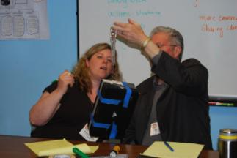
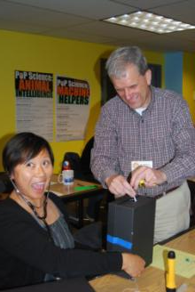
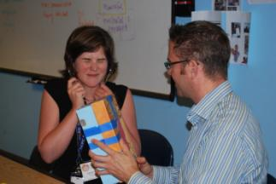
The Pleasure of Finding Things Out Professional Development Element
Pacific Science Center Black Boxes- Examples

Slide 2
Things to think about:
Keep it simple. (its easy to get carried away though!)
Visualize what it will look like when you look into the box through the hole. You don’t want to give it all away, but you also don’t want it to be impossible to figure out.
Think about what tools would help the scientists figure out what features of the box. (ie, work backwards)
Use things you already have around your science center!
Hot glue is highly recommended for construction.
Use your imagination! The possibilities are endless!

Slide 3
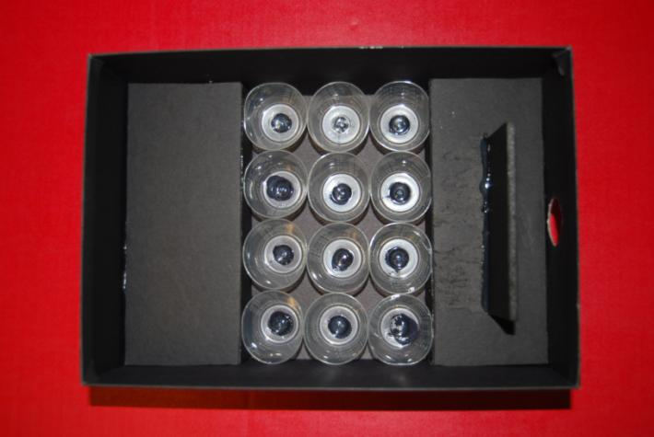
Small medicine cups glued in a trough created by black foam board. The cups sit flush with the raised portions on the left and the right. A piece of foam board is glued just inside the hole so you can not see the entire box by looking in.

Slide 4
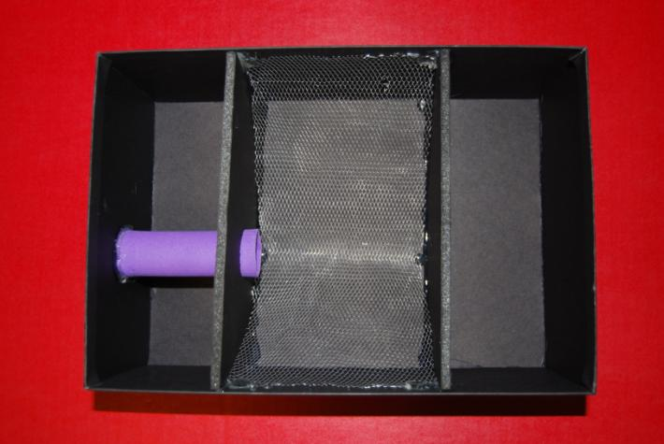
Wire mesh is glued in between two pieces of foam board that are standing upright, creating a compartment within the box. Purple foam paper is rolled into a tube and glued between two holes.

Slide 5
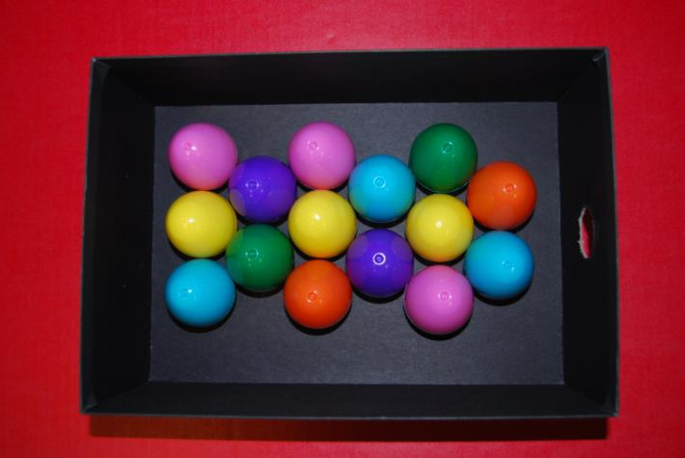
15 empty, closed Easter eggs.

Slide 6
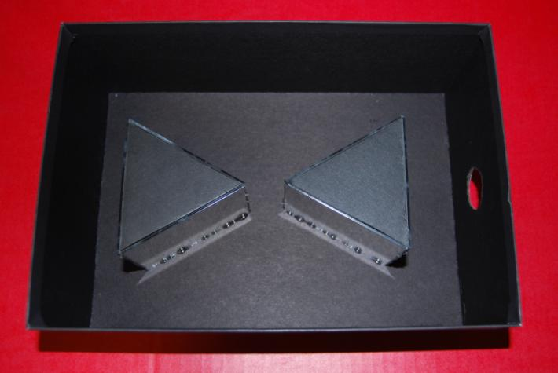
Three small minors are glued together to create the two triangle shapes. They are glued to the base of the box, and black foam board triangles close them off at the top. The two 3D triangles are hallow and inside each there is a loose bell. Its very frustrating, plus when you look in the box you see your own eye looking back at you!

Slide 7
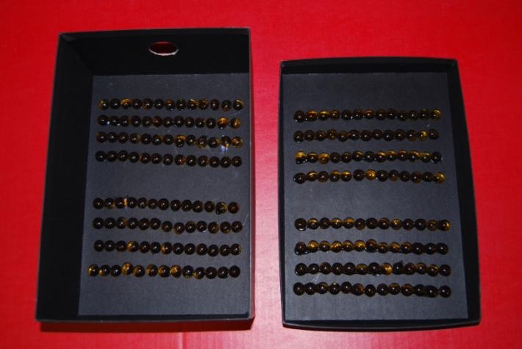
Oblong marble-like glass pieces glued, in rows, to the top and bottom of the box.

Slide 8
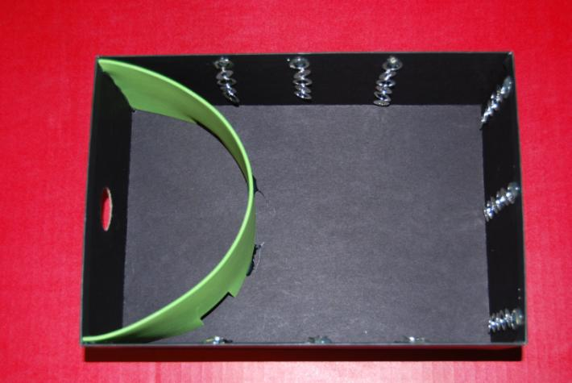
Cut up chain bracelets are attached at the top and loosely hang down the side. The green foam paper has three holes at the bottom where something could pass through.

Slide 9
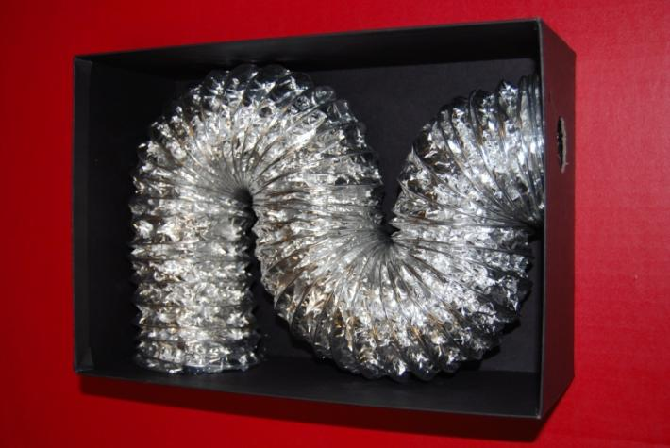
Duct.

Slide 10
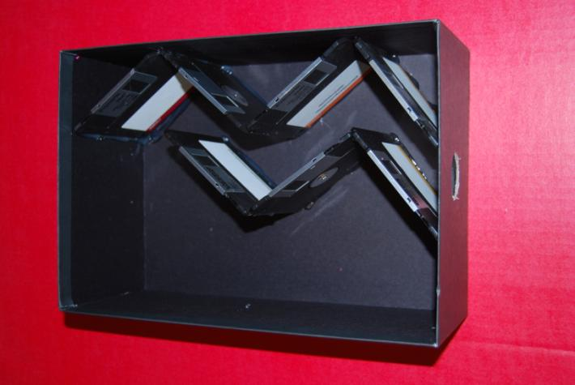
Old floppy disks.

Slide 11
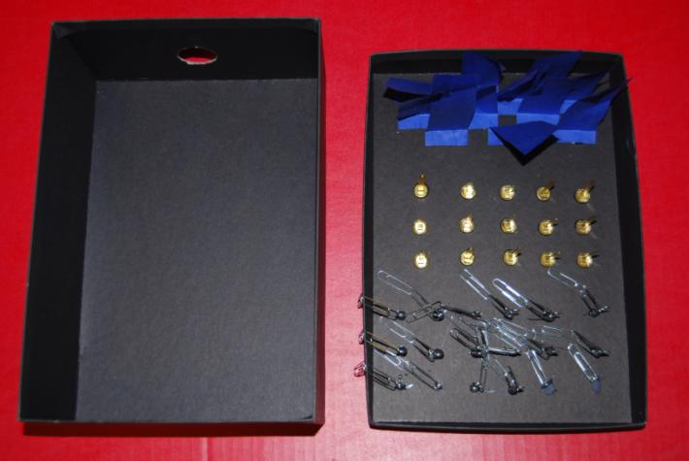
Rows of blue paper, metal brads, and paper clips (strings of 3 paper clips) are glued to the top of the box. There is nothing on the bottom of the box.

Slide 12
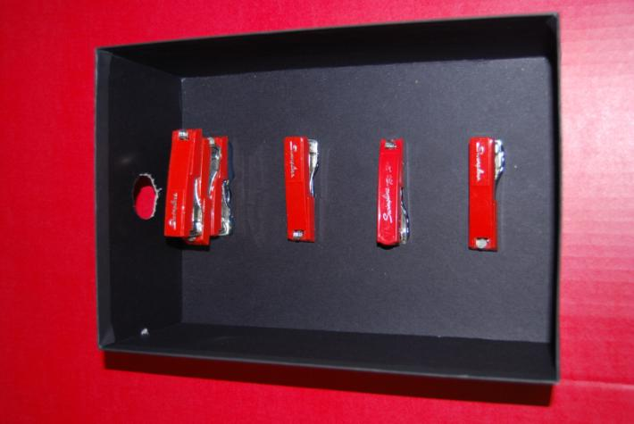
Old mini-staplers. There are three stacked on top of each other right inside the hole, which prevents you from seeing the rest of the box.

Slide 13
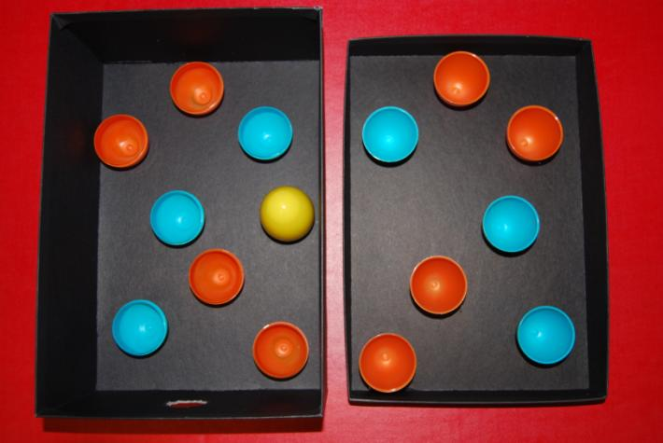
Multi-colored Easter eggs; the bottom of the egg is glued to the bottom of the box and the top of the egg is glued to the top of the box. EXCEPT for the yellow one which is whole and filled with magnetic washers.

Slide 14
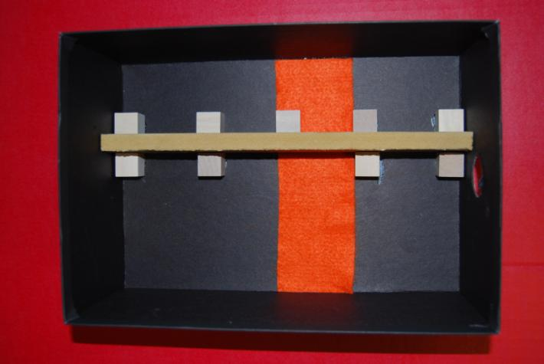
A long piece of wood, about 2 inches high, stretches down the box. Wooden cubes are places on either side. Orange felt is glued to the bottom of the box. It is important that when you look in the hole, you can not see what is on the right side of the piece of wood.

Slide 15
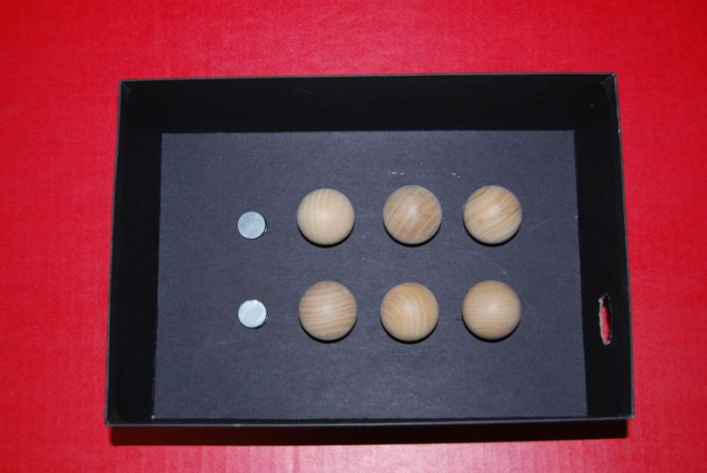
Wooden half circles with two magnets glued behind them.

Slide 16
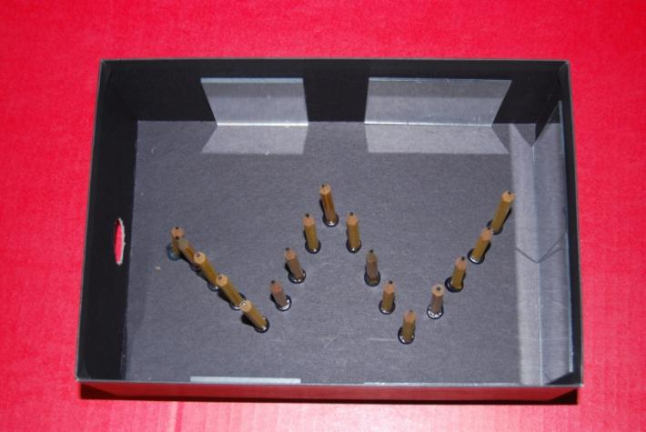
Small mirrors line the inside of the box. Golf pencils are glued to the base of the box in a zig-zag pattern. When you look there appear to be many many pencils!

Slide 17
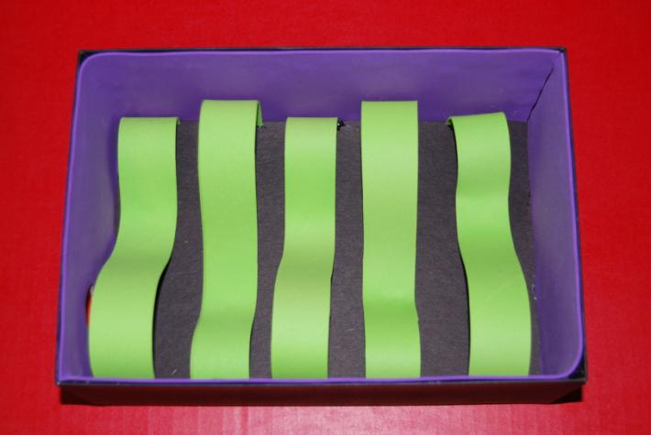
Purple foam paper is glued to the outside of the box. Strips of green foam paper are glued to the base in a wavy pattern.

Slide 18
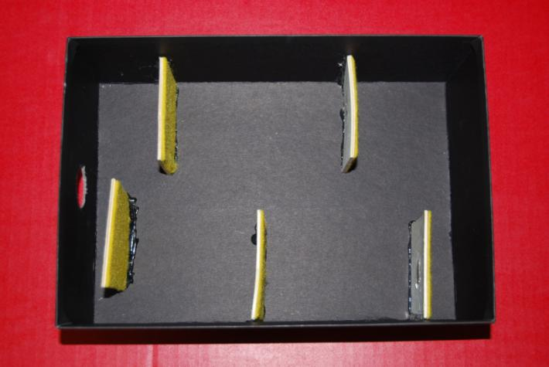
Thin wooden squares are glued to the base. There is yellow felt on one side of each square.

Slide 19
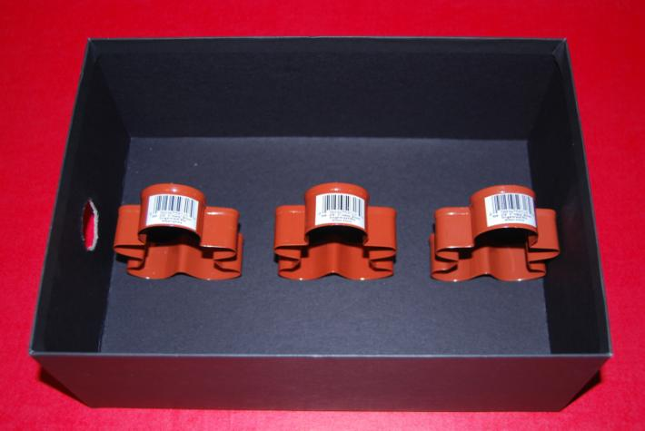
Three little gingerbread cookie cutters!

Slide 20
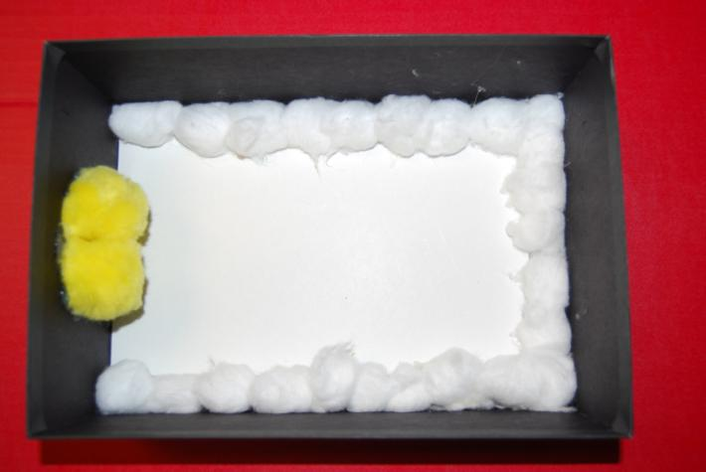
White paper glued to the bottom of the box. Cotton balls line the perimeter. Two large yellow fuzz balls are glued on either side of the hole, but you can still poke things into it.

Slide 21
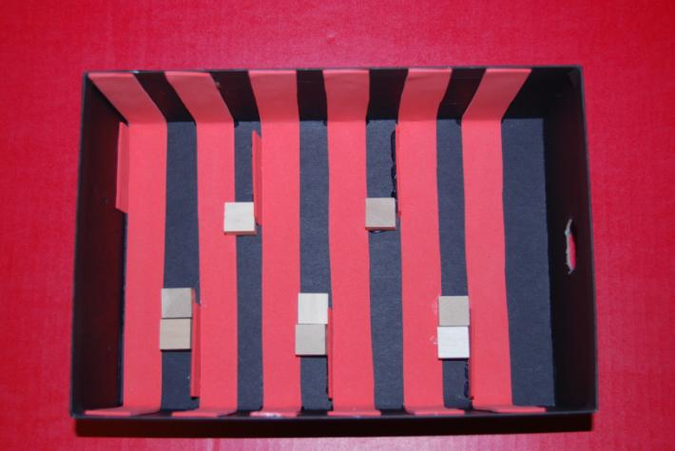
1 inch strips of pink foam paper are glued to the sides and base of the box. 1in x 2in pieces of foam paper are glued upright behind each of the strips, alternating left and right. There are 8 small wooden blocks glued to the base as well.

Slide 22
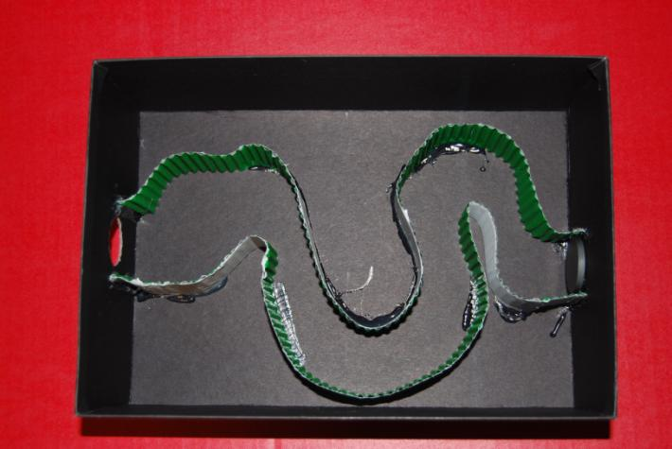
Corrugated cardboard is glued to the bottom in a maze-like pattern. There is a large magnet glued to the end of the “maze”.

Slide 23
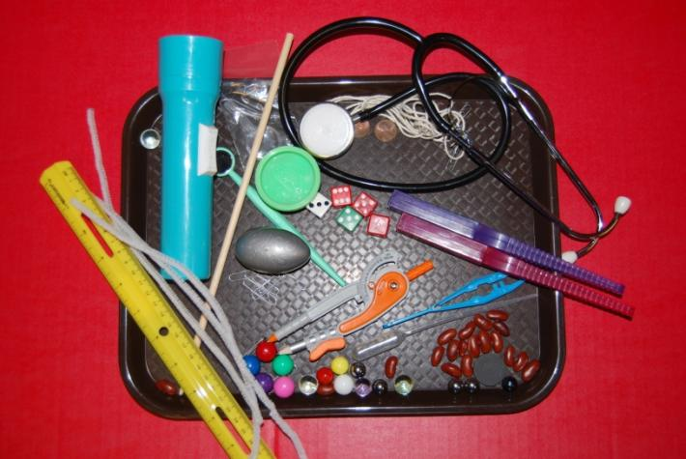
TOOLS!
Tools are important! Some suggestions (not all pictured here): flashlight, magnetic wands, magnetic marbles, ruler, string, compass, stethoscope, silly puddy, play dough, pipe cleaners, tweezers, spring scale, dental mirror, long stick, paper clips, exc.
Be creative!

